Slide 1
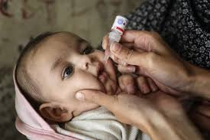
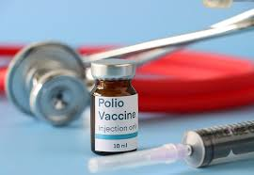
Polio Immunization
1st Slide

Slide 2
What is Polio?
2nd Slide
Definition: Poliomyelitis (Polio) is a viral disease that primarily affects children under 5 years old.
Impact:
Causes paralysis and can lead to death in severe cases.
80% of cases are asymptomatic, but some result in lifelong disability.
Global Statistics:
Polio cases have decreased by over 99% since the 1980s due to immunization efforts.

Slide 3
The Path to Eradication
Challenges:
Political instability, misinformation, and access issues delay vaccination in some regions.
Some regions still have active polio transmission.
Future Goals:
A polio-free world through sustained vaccination efforts and public health awareness.

Slide 4
Polio Transmission and Symptoms
3rd Slide
Transmission:
Polio spreads through contaminated food, water, and contact with infected individuals.
High-risk areas: Regions with poor sanitation and low vaccination rates.
Symptoms:
Mild symptoms: Fever, fatigue, headache, and vomiting.
Severe symptoms: Paralysis in the legs, difficulty breathing (in severe cases).

Slide 5
Polio Immunization: Vaccines
Oral Polio Vaccine (OPV):
A live, weakened virus given orally.
Effective in mass vaccination campaigns.
Inactivated Polio Vaccine (IPV):
A killed virus injected into the body.
Provides stronger protection but requires medical infrastructure for administration.

